Slide 1
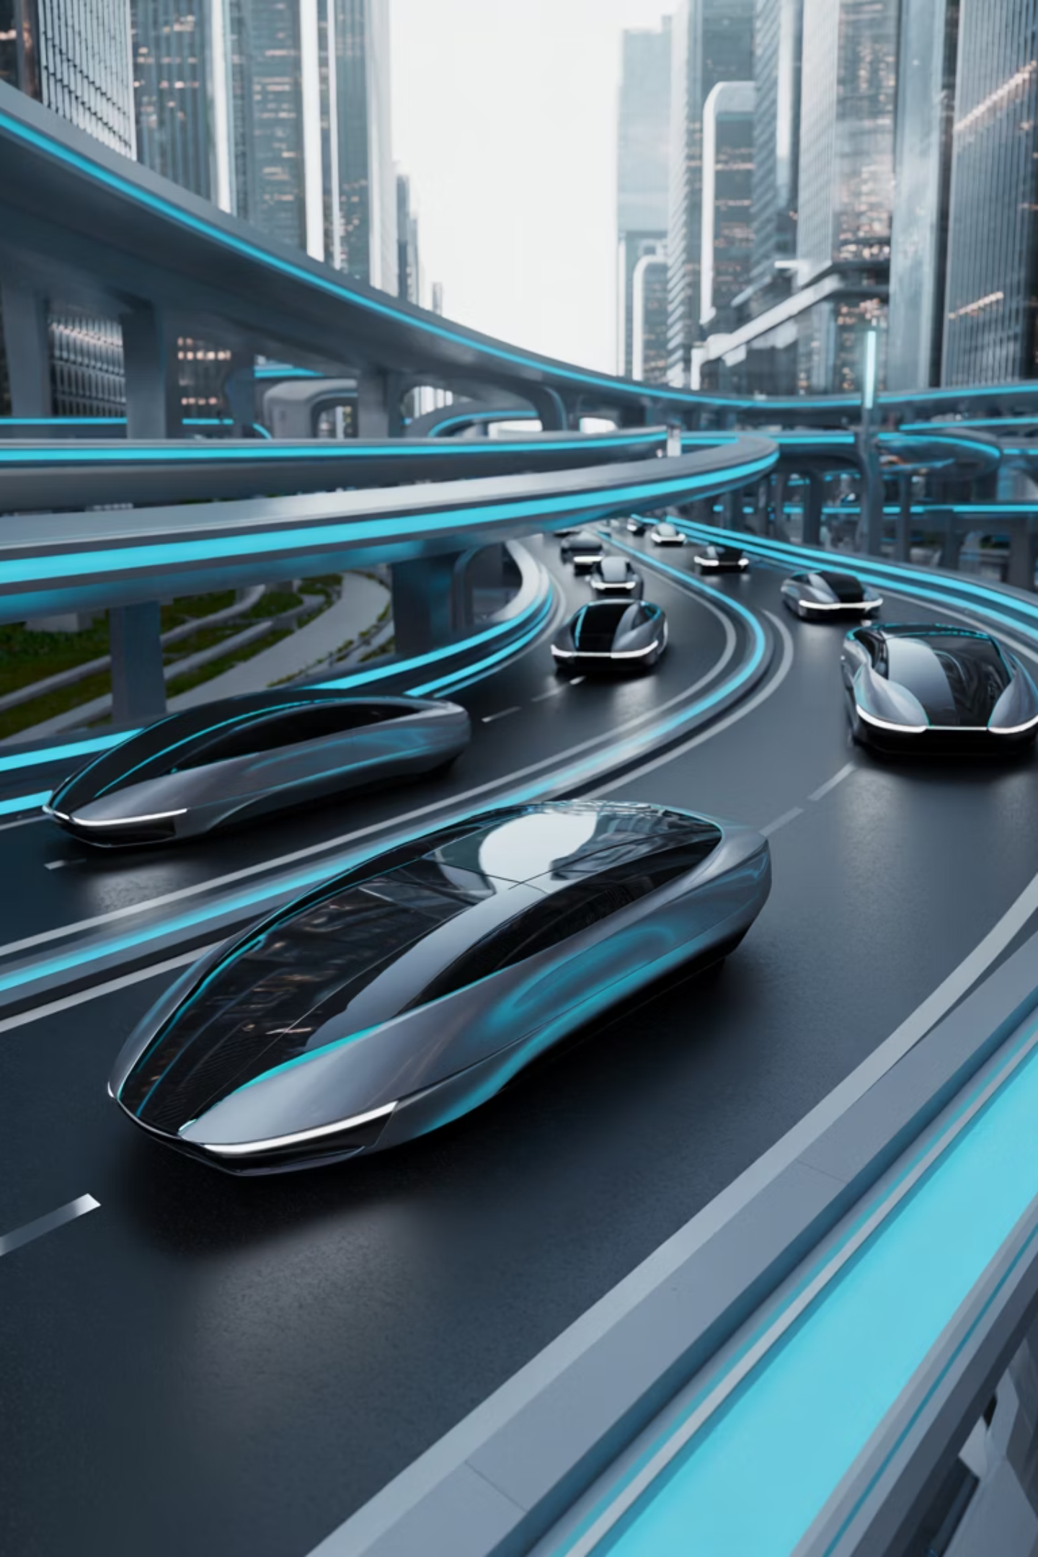
INFOSYS SPRINGBOARD INTERNSHIP 6.0 (BATCH – 04)
(TEAM-A)
NeuroFleetX: AI-Driven Urban Mobility Optimization

Slide 2

INTRODUCTION
The rapid expansion of urban centers presents unprecedented challenges for mobility. Congestion, pollution, and inefficient transportation networks demand innovative solutions. As cities grow, so does the complexity of managing large vehicle fleets, from logistics to public transport.
This scenario highlights a critical need for smart, real-time fleet intelligence that can adapt and optimize operations dynamically. Traditional methods are no longer sufficient to meet the demands of modern urban environments.
NeuroFleetX emerges as a comprehensive solution, leveraging cutting-edge AI to provide advanced optimization and enhance overall urban mobility systems.

Slide 3

PROBLEM STATEMENT
Current Problems
Traffic congestion and delays
Inefficient resource allocation
Environmental pollution
High operational costs
Limited accessibility for citizens
NeuroFleetX addresses these critical issues, aiming to create a more streamlined and eco-friendly urban environment.

Slide 4










NeuroFleetX: Our Solution Overview
Urban Focus
AI-Driven
Tailored for complex city environments.
Intelligent algorithms for dynamic optimization.
Fleet Optimization
Maximizing vehicle utilization and efficiency.
Sustainable
Reducing carbon footprint and energy consumption.
Real-time Data
Responsive adjustments based on live conditions.
NeuroFleetX integrates cutting-edge AI to transform urban transportation into a responsive, efficient, and sustainable system.

Slide 5



The NeuroFleetX Architecture: Tech Stack Deep Dive
Frontend: React
1
User Interaction Layer
Backend: Spring Boot
2
Logic & Data Processing
Database: MongoDB
3
Persistent Storage
Our robust architecture ensures scalability, responsiveness, and seamless integration of various components for optimal performance.

Slide 6

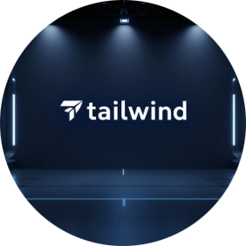


Frontend Technologies: Crafting the User Experience
React
Tailwind CSS
Framer Motion
Material UI (MUI)
Dynamic and responsive user interfaces.
Rapid, responsive styling and layout.
Smooth animations and transitions.
Consistent and modern UI elements.
These technologies combine to deliver an intuitive and visually engaging experience for all users.

Slide 7






Mapping & Data Visualization
Leaflet & React-Leaflet
Chart.js & React-Chartjs-2
Mapbox GL
Interactive, open-source mapping displays.
Interactive data visualizations and charts.
Advanced, detailed, and customizable map rendering.
Visualizing complex urban data and fleet movements on interactive maps is crucial for effective decision-making.

Slide 8

Backend & Data Management: The Engine of NeuroFleetX
Spring Boot: Java-based framework for RESTful APIs and microservices.
Java: Core language for backend logic and data processing.
Maven: Build automation for dependency management.
Axios: HTTP client for seamless API communication.
MongoDB: NoSQL database for flexible and efficient data storage.
This powerful backend stack ensures high performance, reliability, and secure data handling for all operations.

Slide 9
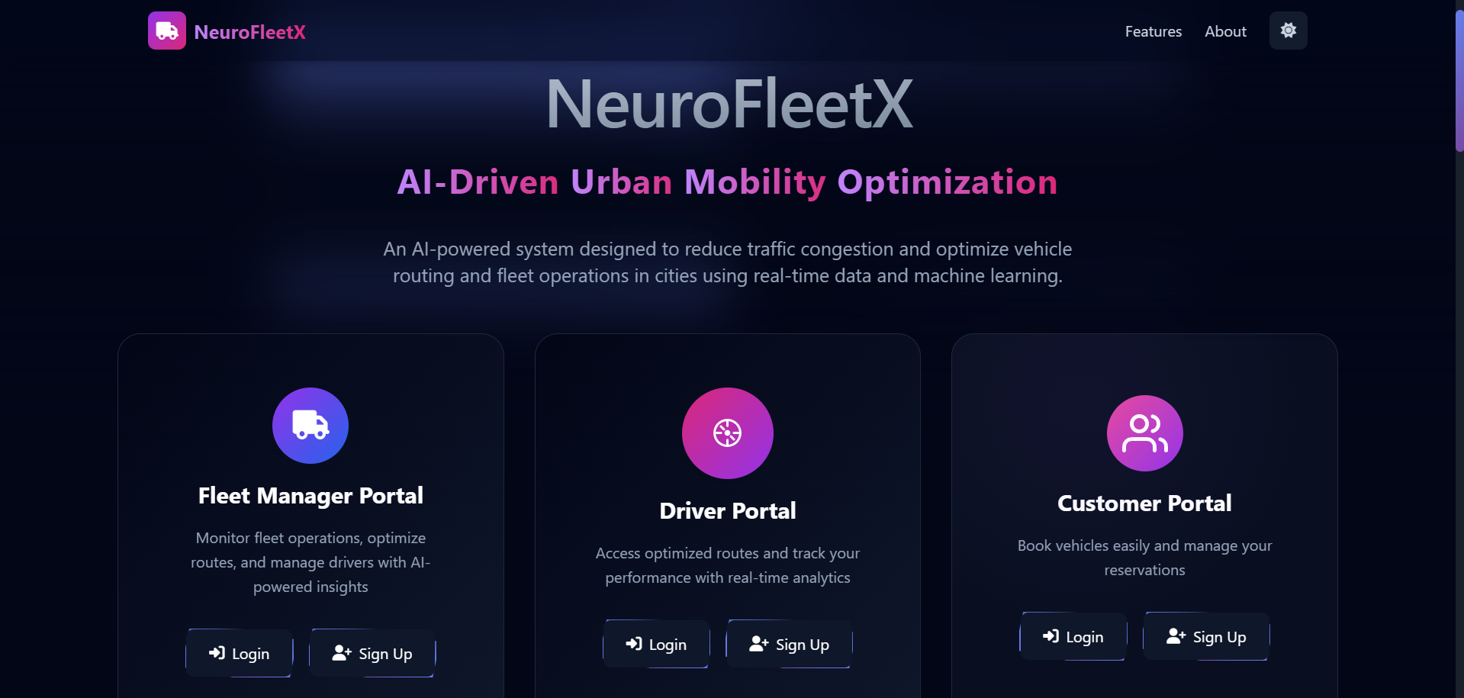
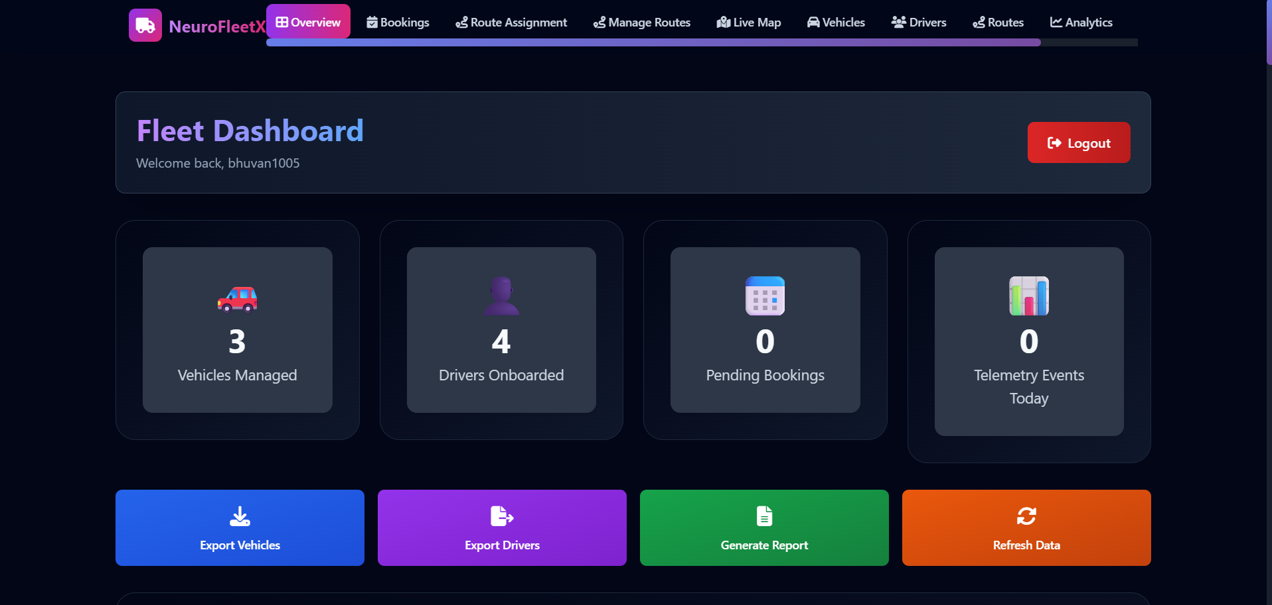
Results/Outputs

Slide 10
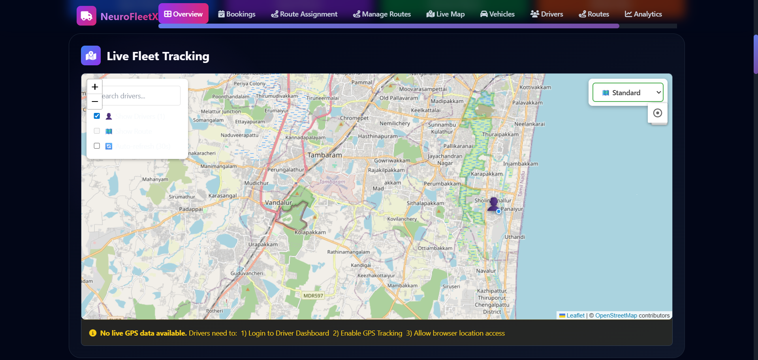

Slide 11
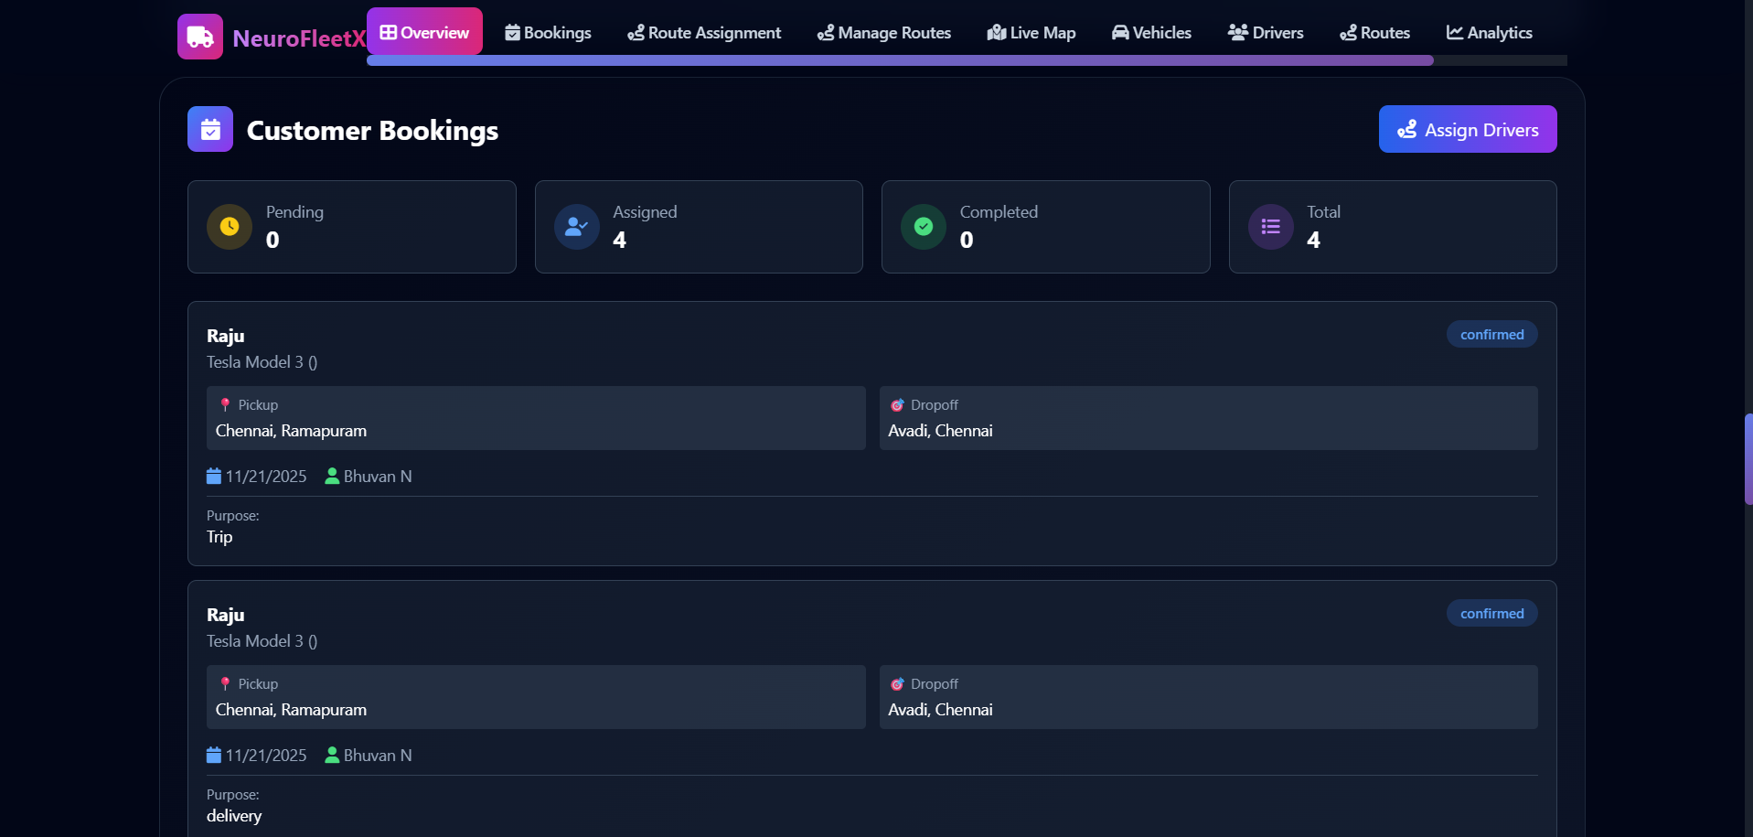
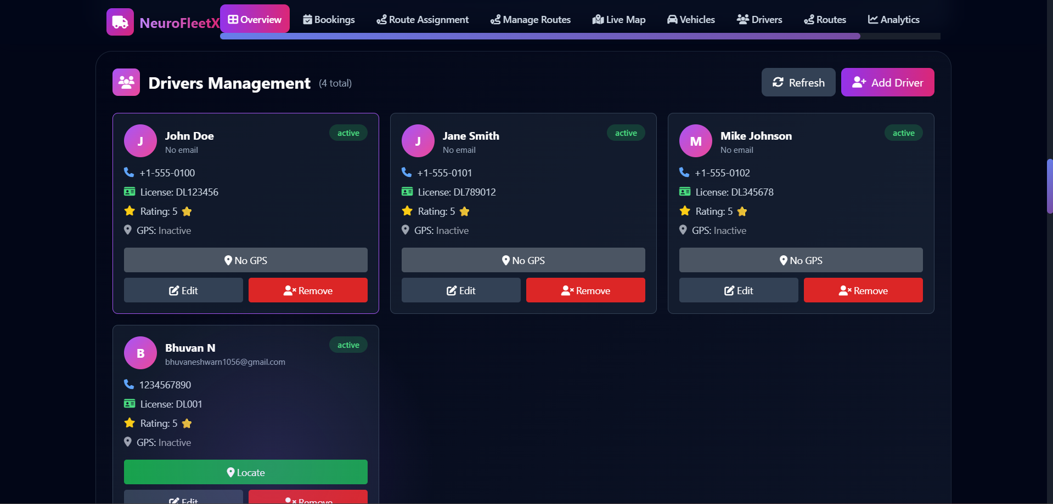

Slide 12
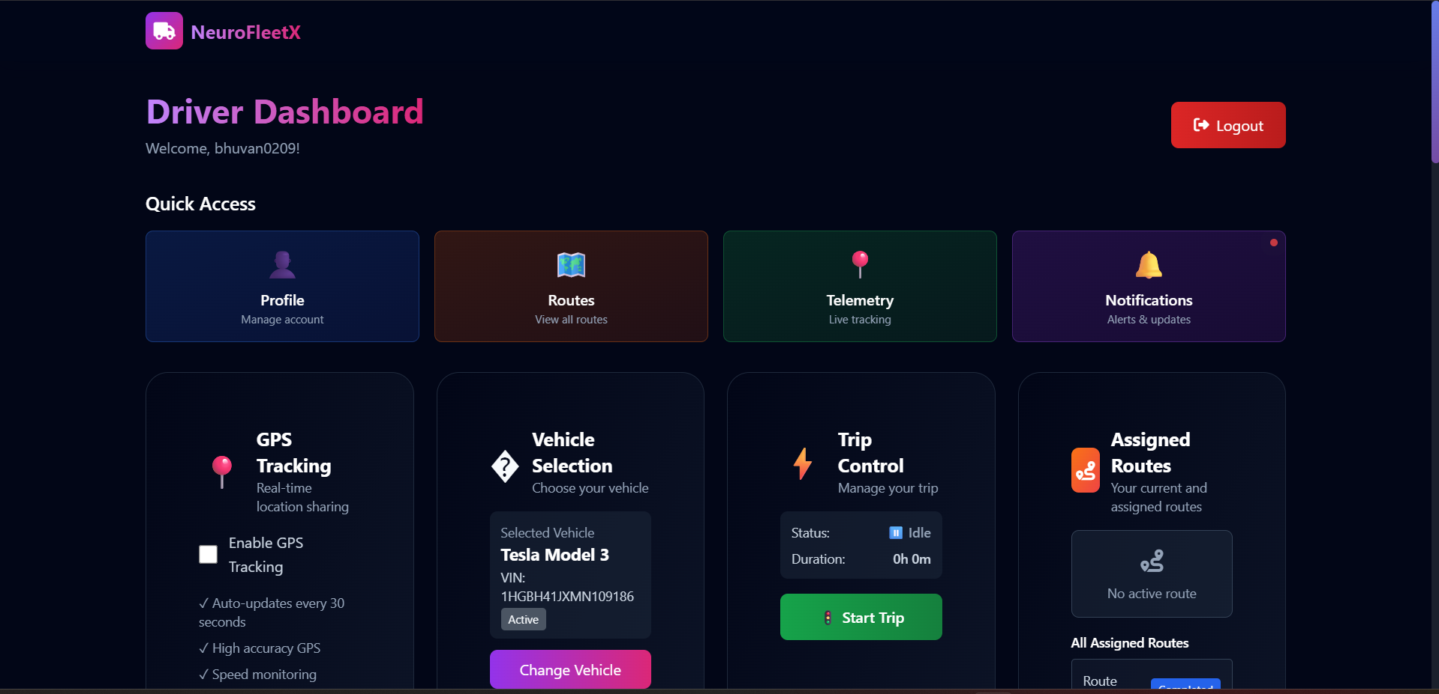
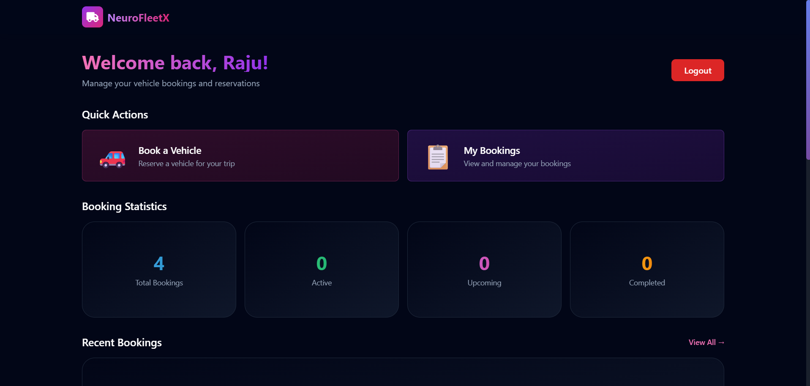
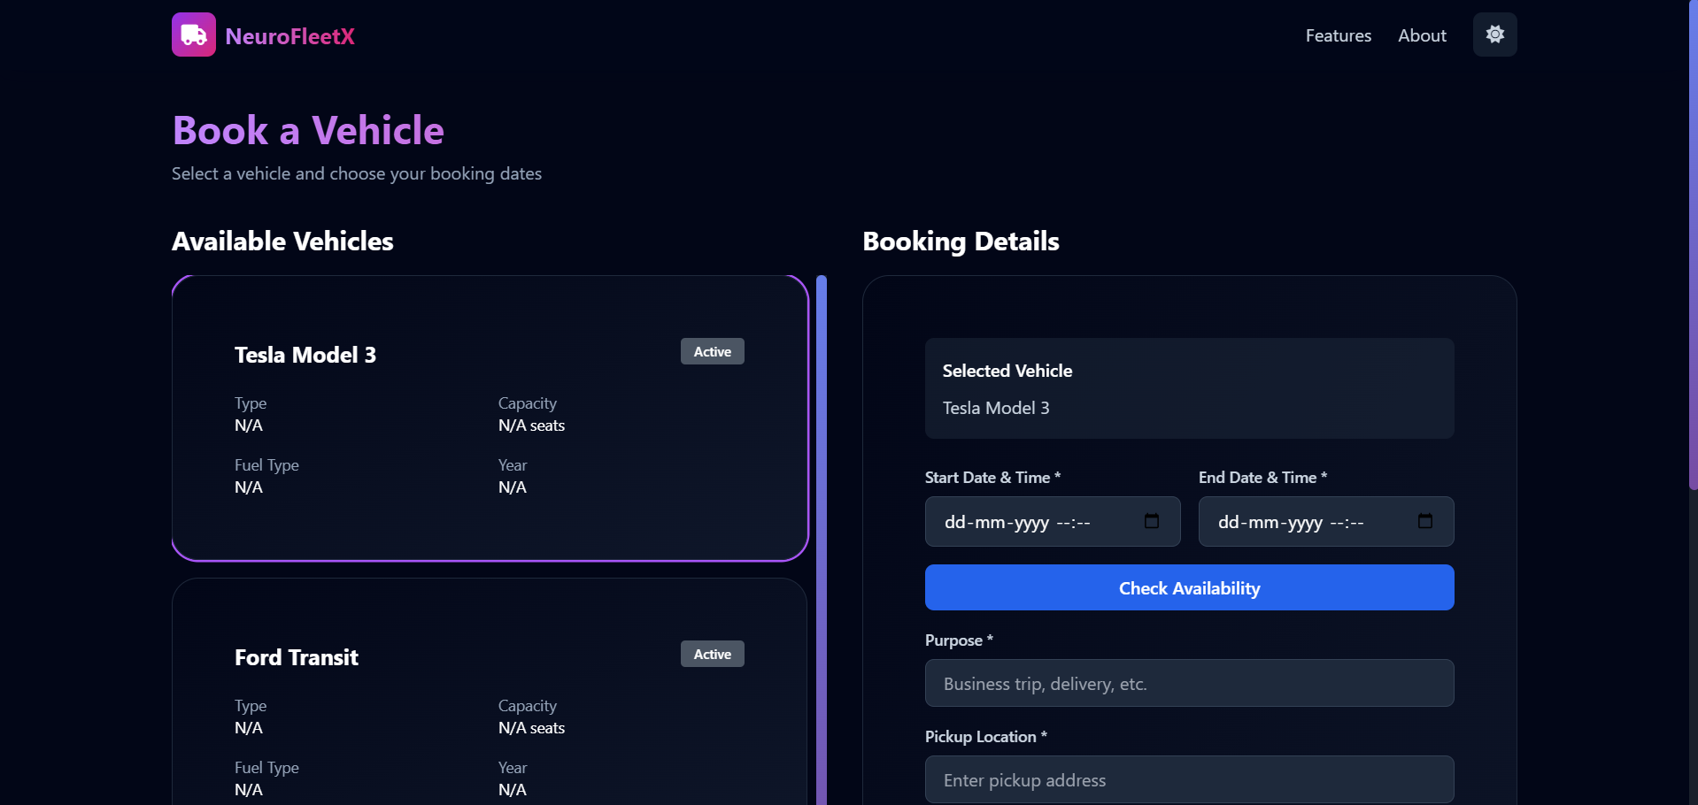

Slide 13
Key Features & Modules
01
02
03
Real-time Fleet Tracking
Predictive Route Optimization
Demand-Responsive Dispatch
Monitor vehicle locations and status dynamically.
AI-driven routing to avoid congestion and delays.
Efficiently allocate resources based on live demand.
04
05
Performance Analytics
User & Admin Portals
Detailed insights into fleet efficiency and impact.
Tailored interfaces for different stakeholders.
Each module is designed to enhance specific aspects of urban mobility, contributing to a holistic optimization system.

Slide 14

Future Enhancements & Vision
Integration with Public Transport
Autonomous Vehicle Support
Seamless multimodal journey planning.
Paving the way for future mobility solutions.
Enhanced Predictive Modeling
Personalized User Experiences
More accurate forecasting for demand and traffic.
Customized recommendations and services.
Our vision extends to a fully integrated and intelligent urban mobility ecosystem, adapting to the evolving needs of cities.

Slide 15

Conclusion & Impact of NeuroFleetX
NeuroFleetX stands as a testament to the power of AI in solving complex urban challenges. By optimizing mobility, we contribute to greener cities, reduced congestion, and improved quality of life for all.
Thank you!

